Slide 1
The French Revolution Begins
World history 10B john rules

Slide 2
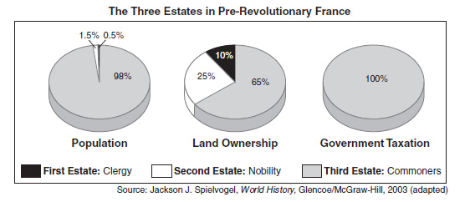
The Three Estates
Before the French Revolution the society of France was based on inequality
There were three estates
The estates are like rigid social classes

Slide 3
The second Estate
Nobles
350,000 people (1.5% of population)
Owned 25-30% of land
Hold many leading positions in government, the military, law courts, and church offices
Exempt from the taille (TAH-yuh), the main tax
The nobles wanted to expand their power at the expense of the monarchy

Slide 4
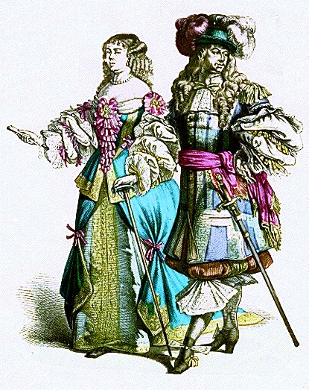
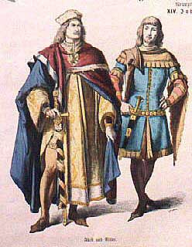
Second Estate

Slide 5
The third estate
Commoners
98% of population
Divided by large differences in occupation, level of education, and wealth
Peasants were the largest segment of this estate
75-80% of total population
Over half of the peasants owned little or no land
Bourgeoisie (middle class)
8% of total population
Merchants, bankers, industrialists, professionals
Owned 20-25% of land

Slide 6
The Third Estate
Members of the bourgeoisie were not happy that the nobles had so many privileges
However, the bourgeoisie shared a lot with the nobles
Wealthy people of the bourgeoisie could become nobles by obtaining public office
Both groups were drawn to the ideas of the Enlightenment
Both groups dislike monarchy

Slide 7
The First estate
Consists of the clergy
130,000 people (0.5% of population)
Owned 10% of the land
Exempt from the taille (TAH-yuh), the main tax in France
This group was divided:
High clergy are members of aristocratic families and share the interests and ideas of the nobles
The parish priests were usually poor and commoners

Slide 8
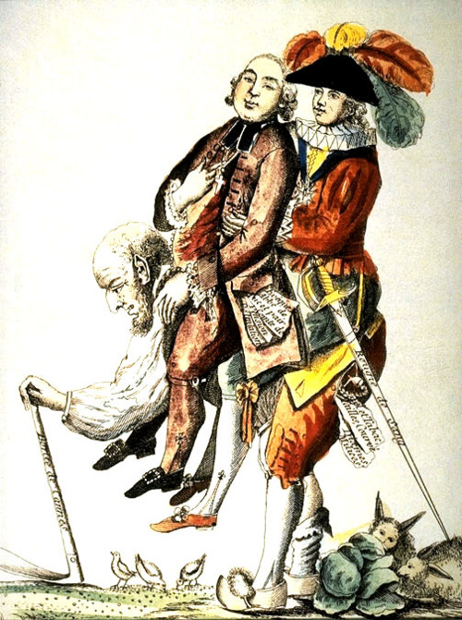
Third Estate Carrying the First and second Estates

Slide 9
Third Estate is the Majority of the Population

Slide 10
Crisis in France
Food shortages
Rising prices
Unemployment
It is estimated that poor people made up 1/3 of the population
“All the country girls and women are without shoes or stockings; and the plowmen at their work have neither shoes nor stockings to their feet. This is a poverty that strikes at the root of national prosperity.” – English traveler

Slide 11
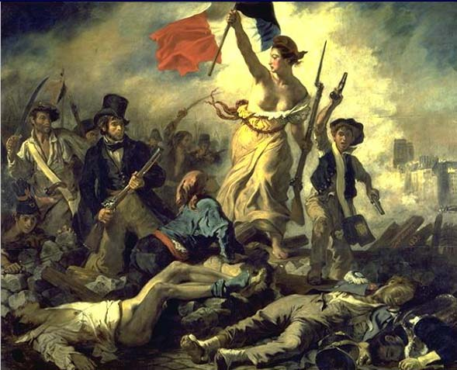
Revolution

Slide 12
The Monarchy’s Response
The French government continues to spend huge amounts of money on wars and court luxuries
Queen Marie Antoinette was known for her extravagance
Spent large amounts of money to help American colonists fight against the British
King Louis XVI was forced to call a meeting of the Estates General (French Parliament) to raise new taxes
France is in danger of a complete financial collapse

Slide 13
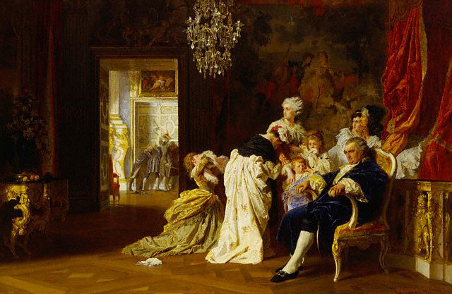
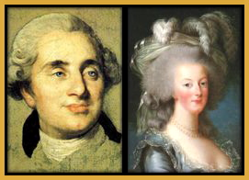
Royal Family

Slide 14
Estates-General
Problems arose at the meeting of the Estates-General
Third Estate wants to tax the First and Second Estates
Each estate gets one vote, meaning the third can be easily out voted
The king, however, refuses to change the voting
The Third Estate decides to leave and become a National Assembly

Slide 15
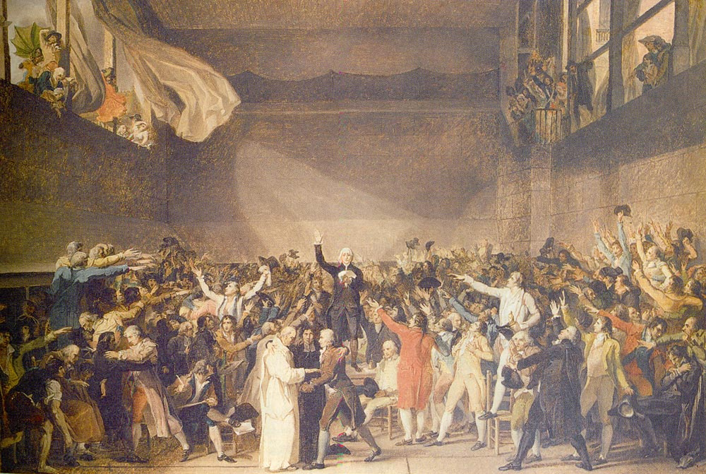
National Assembly

Slide 16
National Assembly
Goal of the National Assembly is to create a constitution
One day they go to their meeting place, only to find themselves locked out
They meet on an indoor tennis court instead
Tennis Court Oath – deputies swear to continue to meet until they have a constitution
Louis XVI prepares to use force against the Third Estate in Paris but the commoners protect them
Louis had also sent his armed forces to stop uprisings due to food shortages

Slide 17
The Storming of the bastille
July 14,1789
The Bastille was an armory and prison in Paris
Only seven prisoners were inside at the time
Parisian mob of 8,000 storm the Bastille to get weapons and free the prisoners
Mob was soon joined by the French Guard, who used cannons against the fortress
The Bastille was dismantled, brick by brick
Mob saw the Bastille as a symbol of the government’s harsh policies
At the same time smaller revolutions broke out all over France

Slide 18
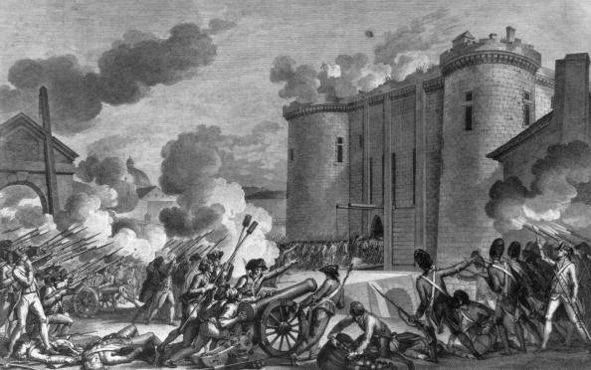
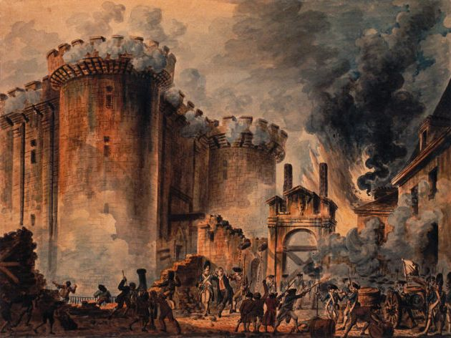
Storming of the Bastille

Slide 19
Declaration of the rights of man
Adopted by the National Assembly in August
The Declaration of the Rights of Man and the Citizen was inspired by:
American Declaration of Independence
American Constitution
English Bill of Rights
Uses Enlightenment ideas
Freedom and equal rights for all men
Access to public office based on talent
No one is exempt from taxes
All citizens have the right to participate in making laws
Freedom of speech and of the press

Slide 20
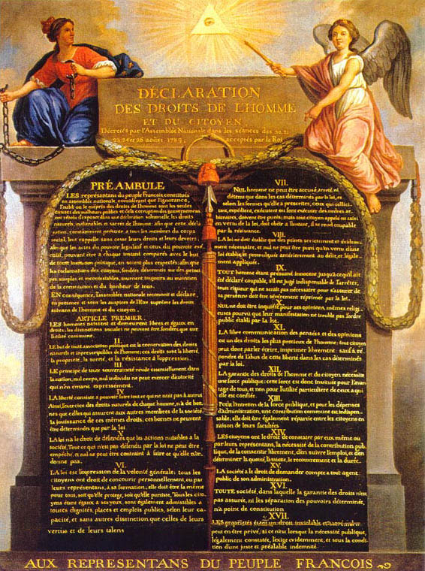
Declaration of the rights of Man

Slide 21
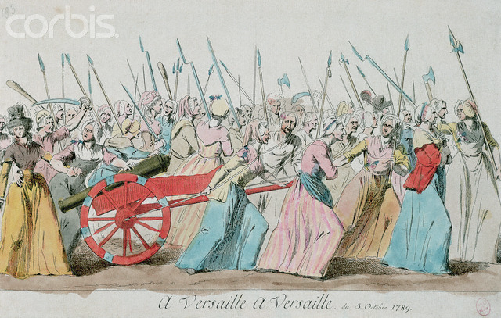
The king concedes
Louis XVI refused to accept the National Assembly and the Declaration of Rights
In October thousands of Parisian women marched to Versailles and force the king to accept these
Crowd forces the royal family to go to Paris, where they essentially become prisoners

