Slide 1
Ethnicity vs. Race vs. Nationality
Geography 9A

Slide 2
What it means
Ethnicity is a source of pride to people, a link to the experiences of ancestors and to cultural traditions.
The ethnic group to which one belongs has important measurable differences.
Ethnicity also matters in places with a history of discrimination by one ethnic group against another.

Slide 3
Controversy & Ethnicity
The significance of ethnic diversity is controversial in the United States:
To what extent does discrimination persist against minority ethnicities?
Should preferences be given to minority ethnicities to correct past patterns of discrimination?
To what extent should the distinct cultural identity of ethnicities be encouraged or protected?

Slide 4
Definition
Ethnicity is an identity with a group of people who share the cultural traditions of a particular homeland or hearth.
Ethnicity comes from the Greek word ethnikos, which means national.
Geographers are interested in where ethnicities are distributed across space, like other elements of culture.
Like other cultural elements, ethnic identity derives from the interplay of connections with other groups and isolation from them.

Slide 5
Why it matters
Ethnicity is an especially important cultural element of local diversity because our ethnic identity is unchangeable
No ethnicity is attempting or even aspiring to achieve global dominance.
In the face of globalization. . . ethnicity stands as the strongest barricade for the preservation of local diversity.

Slide 6
Ethnic Distribution in the U.S.
The two most numerous ethnicities in the United States are African-Americans, about 13 percent, and Hispanics or Latinos, about 11 percent.
In addition, about 4 percent are Asian-American and 1 percent American Indian.
“White” or “Caucasian” is technically a race, not an ethnicity.
German, Irish, French are examples of ethnicities

Slide 7
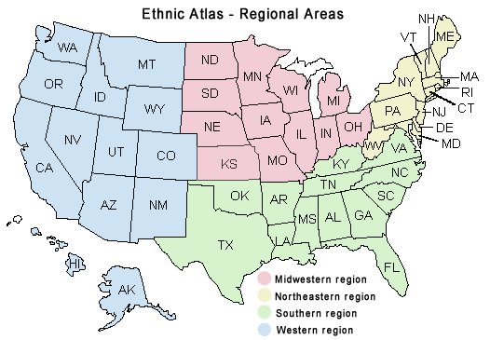
Clustering of Ethnicities in the U.S.
Clustering of ethnicities can occur at two scales, particular regions of the country, and. particular neighborhoods within cities.
African-Americans are clustered in the Southeast, Hispanics in the Southwest, Asian-Americans in the West, and American Indians in the Southwest and Plains states.

Slide 8
Race vs. Ethnicity
Race and ethnicity are often confused.
Ethnicity is about tradition, learned behavior and customs. It is about learning where you come from, and celebrating the traditions and ideas that are part of that region.
Race is your biologically engineered features. It can include skin color, skin tone, eye and hair color, as well as a tendency toward developing certain diseases. It is not something that can be changed or disguised.
Ethnicity gives us room to change because we can reject our own and embrace another. You can move from one region to another and assimilate your beliefs, actions and customs to identify with that ethnic orientation. You cannot do the same with race.

Slide 9
Race vs. Ethnicity
Example:
Asian is a race
Asian-American is an ethnicity
In the U.S. these two terms encompass the same group of people (more or less)
Come up with your own example
At worst, biological classification by race is the basis for racism, which is the belief that race is the primary determinant of human traits and capacities and that racial differences produce an inherent superiority of a particular race

Slide 10
Nationality
Nationality pertains to the country you were born in or are in at present
The piece of land you were born in decides your nationality so if your parents moved to another country just before your birth, you may have a new country for your nationality
You can also choose to make another country your home
To be an American generally means believing in the “unalienable rights” of “life, liberty, and the pursuit of happiness.”

