Slide 1
The American Revolution
American History 11A

Slide 2
Why did the war start?
Britain believes that Parliament had legal authority in the colonies
The French and Indian War
Colonists believed they should have representation in Parliament
No taxation without representation

Slide 3
The Declaration of Independence
Written by Thomas Jefferson
States that the authority to govern belongs to the people, not kings
All people are created equal and have the right to “life, liberty & the pursuit of happiness.”
The colonists were NOT trying to start a war

Slide 4
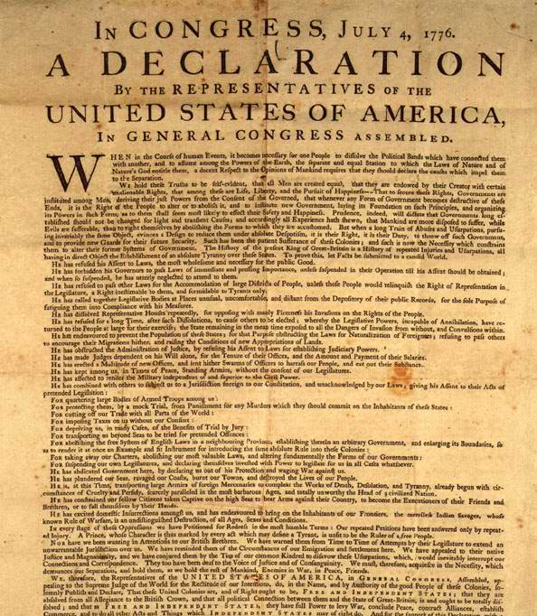

Slide 5
Patriots and Loyalists
Patriots were colonists who supported the break from England
Loyalists are colonists who support England
Colonists are divided

Slide 6
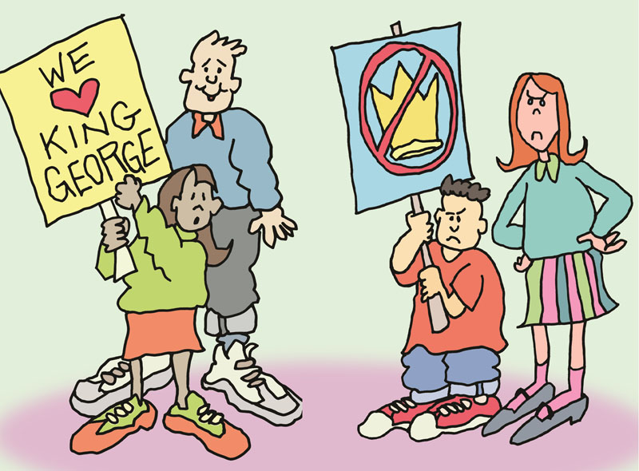
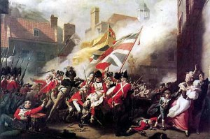
Patriots vs. Loyalists

Slide 7
American Strengths and Weaknesses
The colonists are fighting for independence
George Washington can inspire his men to fight
France will aide the colonists with weapons, supplies, and their navy
The colonists are not a trained army
Colonists enlist for months instead of years
Short on money, weapons supplies to fight a war

Slide 8
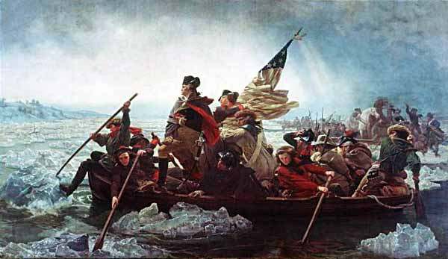
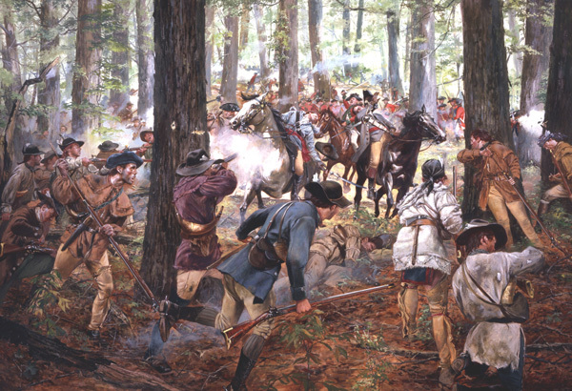
American Strengths and Weaknesses
Guerilla war – when a smaller group uses a hit-and-run strategy, or sabotage to fight a larger army.
Scenes from The Patriot
http://www.youtube.com/watch?v=zQYkIlSx0yg
https://www.youtube.com/watch?v=F-BQi0JjY2w

Slide 9
British Strengths and Weaknesses
The British have an experienced, professional army
Outnumber the Continental Army
The British army is well supplied with equipments and weapons
They are not fighting for a cause
British officers are careless and poor leaders
They must cross the Atlantic Ocean to send men and supplies
The support at home is weak

Slide 10
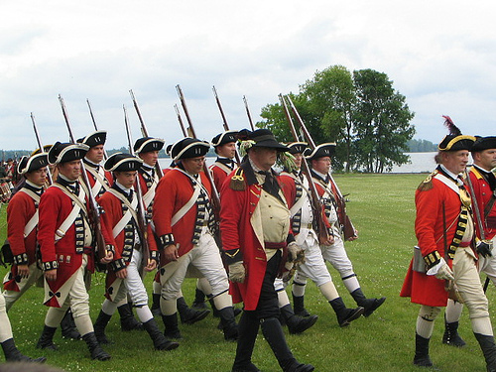
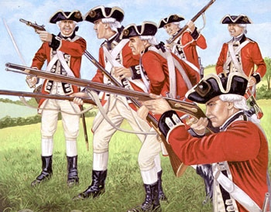
British Army
Scenes from The Patriot
https://www.youtube.com/watch?v=IFpFHj4XfFg

Slide 11
Strategy of War
American Colonies
Britain
Keep the Colonial Army together
Washington seeks to stretch the British away from supplies
Defeat the British in a major battle
Get allies to help
Seek to destroy the Colonial Army
Regain control of the colonies by region
Take the fight to the Colonial Army with European War tactics
Use loyalists support

Slide 12
Important Battles
Lexington and Concord – April 1775
The beginning of the Revolutionary War
The Battle of Bunker Hill – June 16, 1775
Prove the Colonial Army can take the British
The Battle of Saratoga – August-October 1777
Turning point of the war because the French start to believe the colonists can win
French begin to help the Colonial Army
The Battle of Yorktown – October 1781
British surrender and end the war

Slide 13
Treaty of Paris,1783
The colonies become “free, sovereign and independent states”
British must remove all troops from forts
Boundary for the United States is the Mississippi River
Loyalists would have rights and property protected
Captured slaves must be returned to owners

