Slide 1
Understanding your ACT Score
enCompass Academy

Slide 2
What is the ACT?
College readiness test
Standardized
Multiple choice
What will I be tested in?
English
Math
Science
Reading
Writing

Slide 3
When/where will I take it?
Junior year
Usually in February
At school
How long will it take?
4.5 hours
English – 45 min – 75 questions
Math – 60 min – 60 questions
Reading – 35 min – 40 questions
Science – 35 min – 40 questions
Writing – 40 min – one essay

Slide 4
Why should I care?
College admissions
Determines college readiness
  On average students that are not ”college ready” take two years longer to finish school and pay an extra $25,000
It is better to keep your options open just in case
Participation is required, so you may as well do your best
ACT score can test you out of 0-hundred (remedial) level courses

Slide 5
What does my score look like?
You will be scored in each of the following sections:
  Math
  Reading
  Science
  English
In these sections your score will be a number between 1-36
Your scores will be averaged to give you your Composite Score, which will also be between 1-36

Slide 6
What about my writing score?
You will be scored between 2-12 in each of the following areas
  Ideas and analysis
  Development and support
  Organization
  Language Use and Conventions
Your writing score is not a part of your ACT Composite Score
You did not take a writing test when you completed the Pre-ACT
Persuasive writing

Slide 7
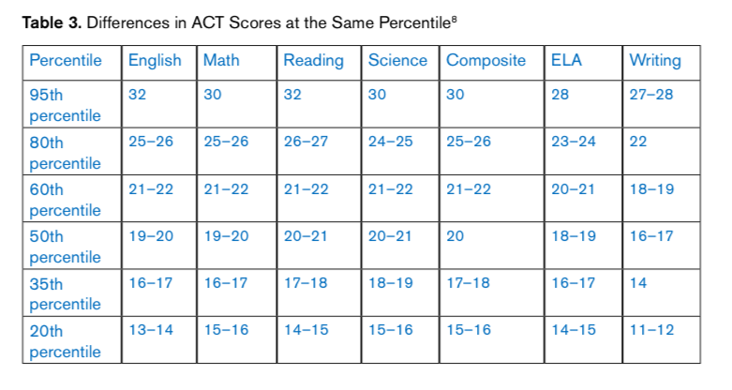
What is a good score?

Slide 8
College Access by ACT Score

Slide 9
Average ACT Scores at…
San Francisco State 18-24
Sierra Nevada College 18-27
CSU: Sacramento 19-22
University of Nevada, Las Vegas 19-24
University of Nevada, Reno 21-26
UC Davis 24-30
Stanford 31-35
Harvard 32-35

Slide 10
Score Report
Scores in each section along top
Purple lines indicate “college readiness”
“College readiness” means that if you score at the purple line you will likely get C’s in that subject at the college level
Detailed results break down scores in each section

Slide 11
Goals
Increase our junior class’s average composite Pre-ACT score from 16.3 to 18 on ACT by 2021
  Junior class
  Class of 2022
Rewards include: free dress days, pancake breakfast or pizza lunch, etc.

